Slide 1
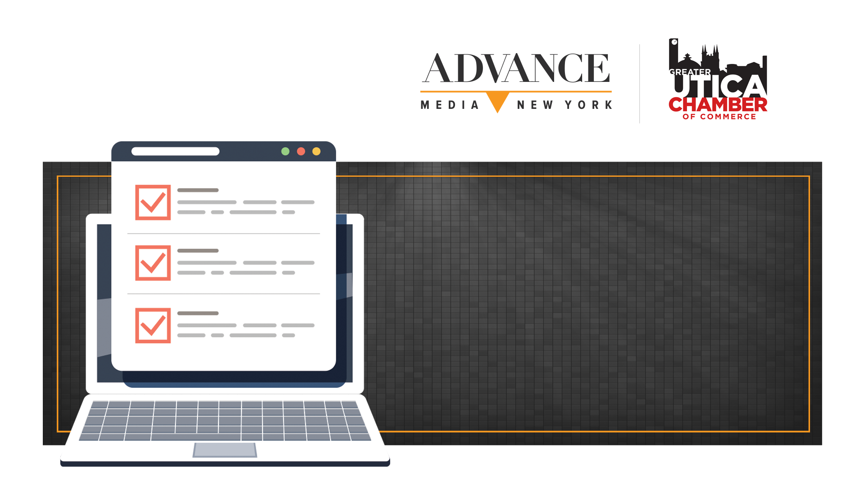

7 ways to improve your website

Slide 2
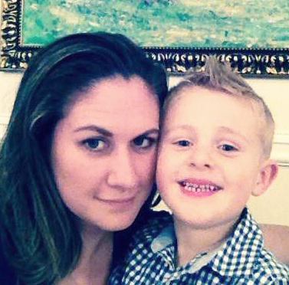
Julie Perkins- Director of Search
Director Of Digital Strategy- Advance Media NY
Hockey Mom
Upstate New York native
Twin

Slide 3

Your website represents your business
24 hours a day, 7 days a week.
What does your website say about your business?
Notes:
Your website in the only thing you own online
It’s a full time employee

Slide 4
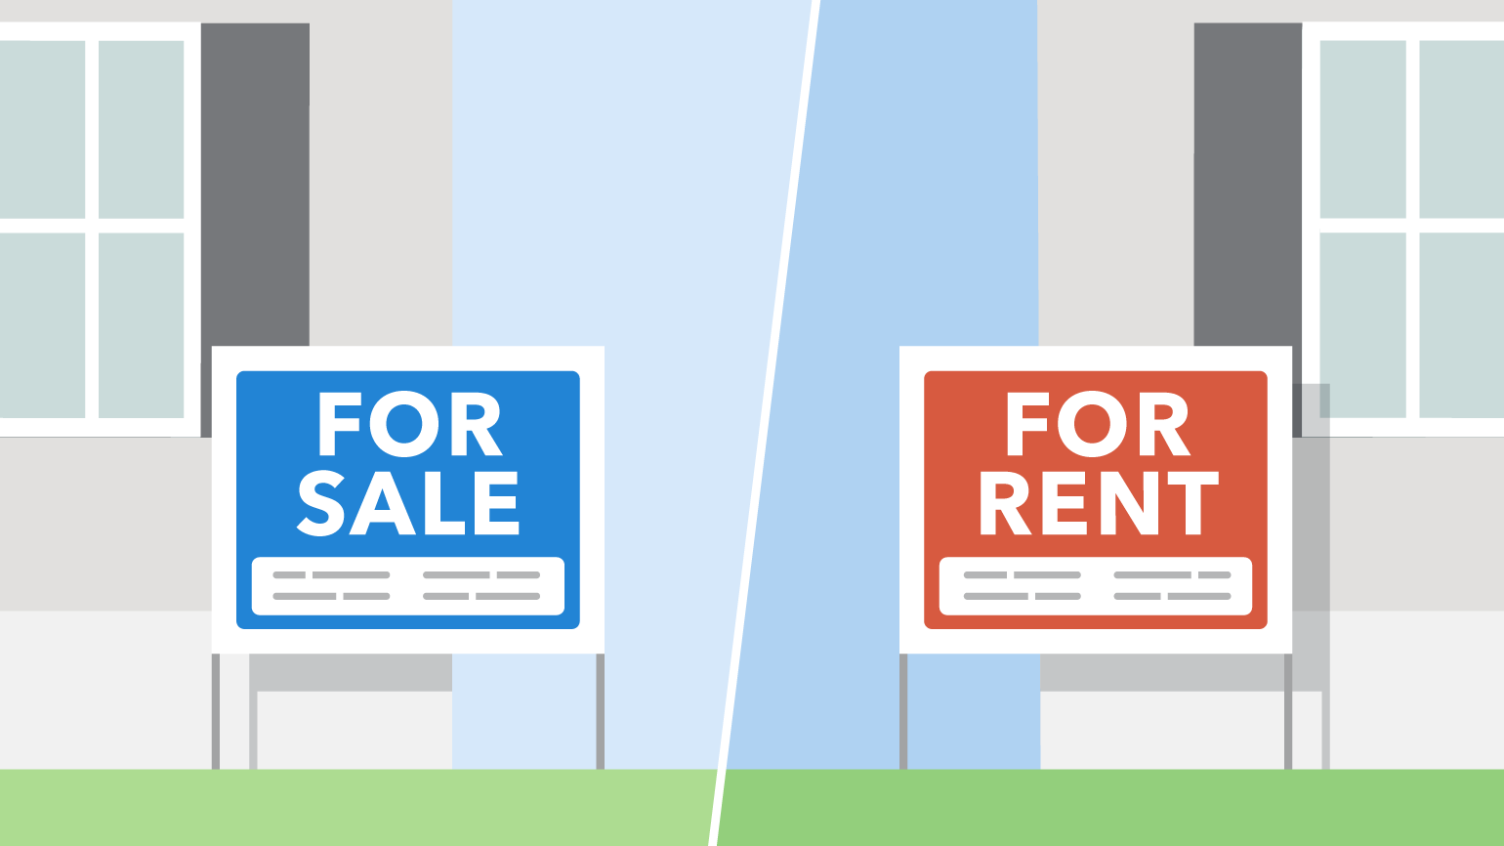
Your website is the only thing you own online
INVEST IN IT.
Notes:
Its important to Work on building its content and authority because is residual- continues to pay off for you down the road
Real estate analogy
Similar to investing in a good location or building a beautiful retail building – it has lasting benefits

Slide 5

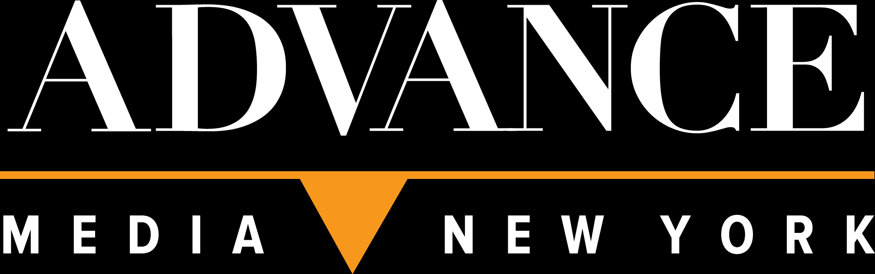
.
89%
.
15
.
seconds
1/3
Notes:
What we are talking about today is how to improve your site? The goal today is for you to learn some tips and tricks you can use to make your website better. Or maybe you need a new site altogether Here’s why it’s so important:
- 89% of consumers begin their buying process with an online search ⁽Fleiscman-Hillard). Your website is usually the first and most powerful presentation of your business – who you are as a company, what you offer, and why your products and services are better than all the rest. That’s why it needs to be beautiful, frictionless, and intuitive.
You have 15 seconds to capture their interest.
- One third of all new websites fail (HubSpot)

Slide 6

.
Reasons Visitors Leave Your Website
(and never come back)
Notes:
It isn't responsive (mobile-friendly)
Your design is outdated
It takes forever to load - 61% of users are unlikely to return to a mobile site they had trouble accessing. And, even worse, 40% visit a competitor’s site instead. (Google)
You have dormant blogs and outdated content
Your navigation is confusing
It’s not usable by people with disabilities
There’s no clear value proposition (what can this site do for me?)

Slide 7
7 ways to improve your website
Notes:
Before we begin, just a few housekeeping things:
We will email the presentation with notes.
Please continue eating throughout.
Ask questions anytime.

Slide 8

.
1. Add Content
Notes:
Probably the most important thing you can do for your website. 77% of consumers read online content prior to making a purchase.
The vast majority of the time a sales prospect’s first website visit will not be enough to compel the sale. High quality and convincing content can serve as the motivation for the prospect to revisit your site in the future and lead to increased sales over time. Posting relevant, valuable and frequently updated content will boost search engine optimization (SEO), position you as an authority in your industry, and help you build relationships with your audience.
Search engines love content, especially frequently updated content. How many pages do you have detailing your company’s products and services on your website? Probably a limited number. In a blog, for example, you can add fresh, relevant content virtually every day. Every additional page of content is potentially a new entry point for your website.
Examples of content: Blog posts (800-1,000 words or more), articles, whitepapers, infographics, podcasts, listicals, company news, case studies, testimonials, checklists, surveys...and VIDEO...a very important thing!
Importance of video: More video content has been uploaded to the web in the last 30 days than the major U.S. TV networks have created in the last 30 years.
You are 53 times more likely to rank on the first page of Google when you use video.
People spend on average 2.6 times more time on pages with video than without, and viewers retain 95% of a message when they watch it in a video compared to 10% when reading it in text.
More than 50% of consumers want to see videos from brands – more than any other type of content; but keep it short ‘n sweet; 67% of consumers prefer video under 60 seconds.
Almost 50% of web users look for a video before visiting a store.
After watching a video, 64% of users are more likely to buy a product online.
The top two most effective types of video content are:
Customer testimonials…customers spend 31% more with businesses which have good customer testimonials.
Demonstration videos…74% of users who watched an explainer video to learn more about a product or service subsequently bought it.
92% of people who consume mobile videos share them with other people.
75% of executives watch work-related videos on business websites at least once a week, 65% of executives will visit a website after viewing a video, and 39% will call a vendor.
59% of company decision makers would rather watch a video than read an article or blog post.
Embedding videos in landing pages can increase conversion rates by 80%.
53% of smartphone users feel more favorable towards companies whose mobile sites or apps provide instructional video content.

Slide 9
.
Content Tips
1. Use market research to determine the content of your website.
2. Use keyword research to determine the content of your website.
3. Avoid Stock Photography.
4. No worries if you don’t have a fancy camera to shoot video.
5. Add internal links.
Notes:
Content tips:
1. Use market research to determine the content of your website. This way, you’re providing your users with the content they want, need and expect…not what you think they want, need and expect. Determine your high value customers and how you will target them. The content on your website should target your high value customers, engage them, and persuade them to take action.
2. Use keyword research to determine the content of your website.
3. Avoid Stock Photography. You may think a stock picture is a perfect fit for your website, but there are feasibly thousands of other websites using the exact picture. Nothing complements and represents your business more effectively than professional and original photographs of your products, customers, team and facilities. Custom photography makes your website stand out among the rest, and they lend credibility and connect with the visitor on a personal level. Using custom photography also provides the opportunity to incorporate your marketing message and brand into photographs. This will greatly improve the marketing power of your website.
4. No worries if you don’t have a fancy camera to shoot video. Your smartphone is probably just fine to get started. We typically use a professional grade video camera, and the iPhone, Samsung Galaxy or Google Pixel work in a pinch. You can do it alone or enlist the help of a marketing agency who will help you bring your vision to life and make the most of your video by crafting a strategy to get it out to your target audience.
5. Add internal links. Content also provides a great opportunity for internal links. An internal link is text within the content that is hyperlinked to another relevant page on your website. Internal linking is a great way to lead users to additional information that they may be looking for. Search engines also like to see internal links throughout a website. As search engines crawl and index the pages on your site, they often move from one page to the next through internal links. Therefore, internal links may help the pages on your website to be indexed and understood by search engines faster.
Probably the most important thing you can do for your website. 77% of consumers read online content prior to making a purchase.
The vast majority of the time a sales prospect’s first website visit will not be enough to compel the sale. High quality and convincing content can serve as the motivation for the prospect to revisit your site in the future and lead to increased sales over time. Posting relevant, valuable and frequently updated content will boost search engine optimization (SEO), position you as an authority in your industry, and help you build relationships with your audience.
Search engines love content, especially frequently updated content. How many pages do you have detailing your company’s products and services on your website? Probably a limited number. In a blog, for example, you can add fresh, relevant content virtually every day. Every additional page of content is potentially a new entry point for your website.
Examples of content: Blog posts (800-1,000 words or more), articles, whitepapers, infographics, podcasts, listicals, company news, case studies, testimonials, checklists, surveys...and VIDEO...a very important thing!
Importance of video: More video content has been uploaded to the web in the last 30 days than the major U.S. TV networks have created in the last 30 years. Nearly 90% of online marketers are currently using video content, 51% name video as the type of content with the best return on investment, and 50% of advertisers are shifting budgets from TV to digital video. It’s no wonder, when you look at the statistics:
You are 53 times more likely to rank on the first page of Google when you use video.
People spend on average 2.6 times more time on pages with video than without, and viewers retain 95% of a message when they watch it in a video compared to 10% when reading it in text.
Video marketers get 66% more qualified leads per year.
More than 50% of consumers want to see videos from brands – more than any other type of content; but keep it short ‘n sweet; 67% of consumers prefer video under 60 seconds.
Almost 50% of web users look for a video before visiting a store.
After watching a video, 64% of users are more likely to buy a product online.
57% of retail brands say their average order values increase when users watch just one video they’ve produced, and sales totals double when people have watched 10 or more videos.
92% of people who consume mobile videos share them with other people.
The top two most effective types of video content are:
Customer testimonials…customers spend 31% more with businesses which have good customer testimonials.
Demonstration videos…74% of users who watched an explainer video to learn more about a product or service subsequently bought it.
75% of executives watch work-related videos on business websites at least once a week, 65% of executives will visit a website after viewing a video, and 39% will call a vendor.
59% of company decision makers would rather watch a video than read an article or blog post.
Embedding videos in landing pages can increase conversion rates by 80%.
53% of smartphone users feel more favorable towards companies whose mobile sites or apps provide instructional video content.

Slide 10



What are we doing when we use Search Engines?
We are asking
a question
Notes:
We are asking a question

Slide 11
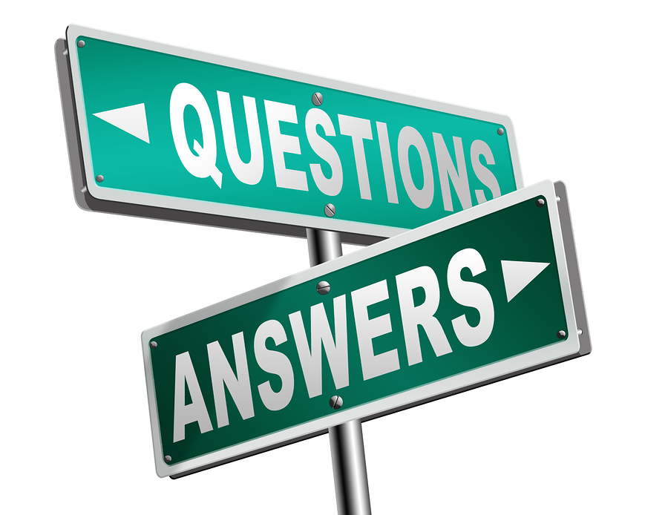
Your Website Answers
Those Questions
Notes:
The pages on your website should answer the questions

Slide 12
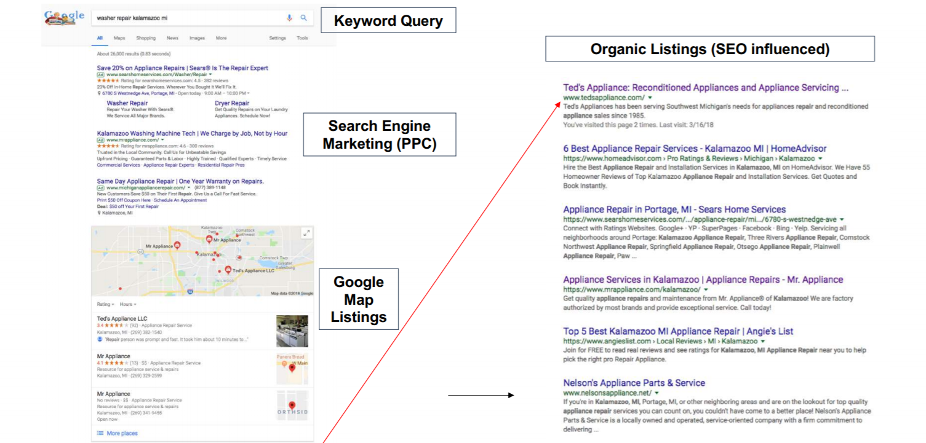
What does organic ranking mean?
Notes:
Well over 90% of clicks are on the first page- very few people go past page 1
The #1 organic result drives 33% of clicks
Some studies show that The top 3 organic results (#1, #2, #3) capture up to 61% of clicks
Source:https://www.protofuse.com/blog/details/first-page-of-google-by-the-numbers/

Slide 13

2. Make it responsive
.
3. and secure
A D V A N C E M E D I A N E W Y O R K
Notes:
Make your site responsive…and secure. A mobile-friendly website isn’t good enough anymore; it needs to be responsive. When a website is responsive, the layout and content automatically adapt to fit the device you’re reading it on, be it a desktop, laptop, tablet, or mobile phone. Mobile traffic makes up the largest share, with more than half of all web traffic coming from mobile devices according to Statista.
Google says 61% of users are unlikely to return to a mobile site they had trouble accessing. And, even worse, 40% visit a competitor’s site instead.
Also consider: search engines take into account your website design, it’s easier to manage a responsive site than having to worry about a desktop site and a mobile-friendly site, responsive sites are “future-proof” against the ever-changing size of smartphone screens and the “mobile-only” model Google and other search engines may be moving towards, and you’ll gain an advantage over competitors. If your site is not responsive, you need to start over. If you have a site which is not responsive, it’s like having an office which no one can get into.

Slide 14
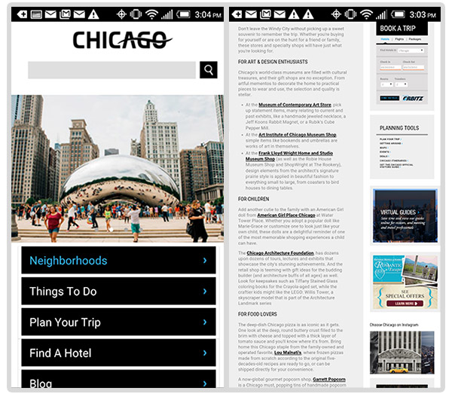
Notes:
Which would you rather read?

Slide 15

HTTPS – What does it mean?
Notes:
What does this mean?
If a website has a password protected web page or collects information via online forms, an SSL certificate provides an additional layer of security to protect against bots and hackers.
SSL also shows users that a website can be trusted by authenticating business information and confirming that they are, in fact, communicating with the business
Websites can have a secure connection standard by obtaining an SSL Certificate.

Slide 16
HTTPS: Historical SEO Context
August 2014
November 2016
January 2017
HTTPS becomes a ranking factor
July 2018
HTTPS grows in importance as a ranking factor
Chrome begins marking sites with forms that have <input type=password> as the red “not secure”
All sites on HTTP will be marked as “not secure

Slide 17
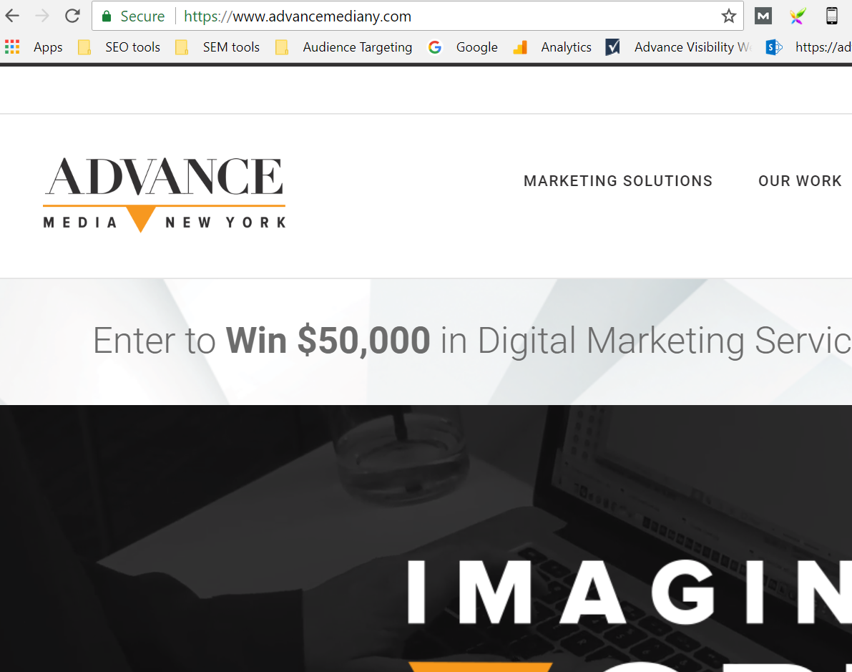

Slide 18
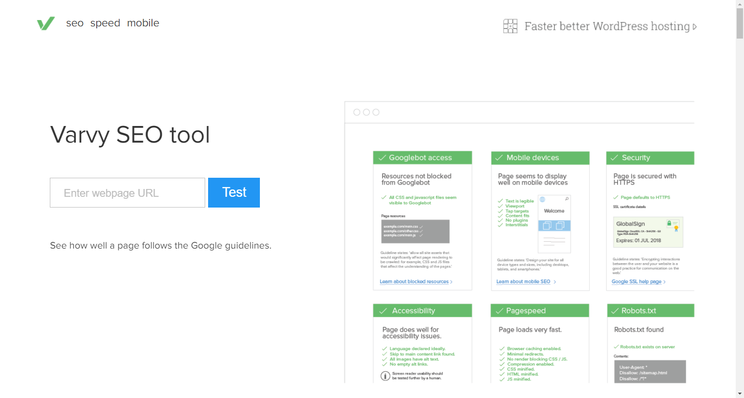
HTTPS – How Do I Check?

Slide 19

4. Boost Your
.
Page Speed
.

Slide 20
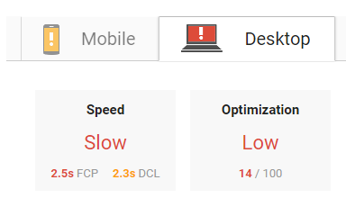
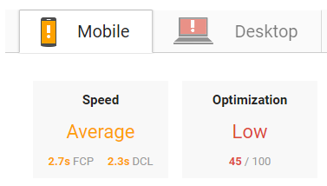
Page Speed - What is it?
Notes:
Page speed is a measurement of how fast the content on your page loads. According to Google, the average load time of a mobile landing page in the U.S is 8.7 seconds. However, 53% of people will leave a mobile page if it takes longer than 3 seconds to load. A one second delay in webpage time equals a 7% reduction in conversions, 11% fewer page views and 16% reduction in customer satisfaction. Find out how your site stacks up with Google PageSpeed Insights, a free online resource which analyzes the content of a web page, then generates suggestions to make that page faster. Just type in your URL and watch it go.
Tips to improve page speed:
size your images appropriately for the space it’s going in
make sure the resolution of images is for web not for print.
Embed video link, i.e. a YouTube link, instead of using your own video player…helps with keeping up the site because you’re using YouTube’s technology.
There’s a variety of other things you can do to increase page speed…an expert can help you evaluate.

Slide 21
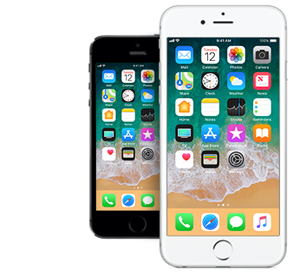
Mobile Page Speed as a Ranking Factor
April 2010: Desktop page speed became a ranking factor:
  https://webmasters.googleblog.com/2010/04/using-site-speed-in-web-search-ranking.html
July 2018: Mobile page speed becomes a ranking factor:
  https://webmasters.googleblog.com/2018/01/using-page-speed-in-mobile-search.html

Slide 22
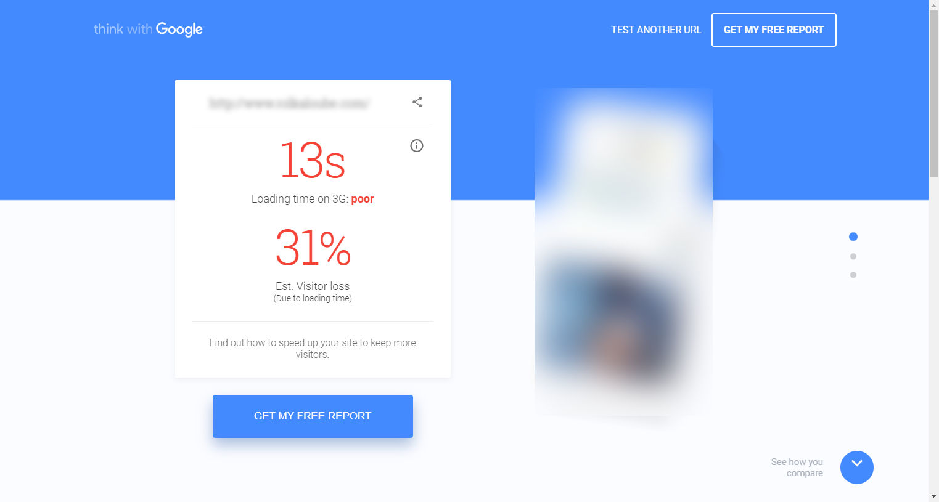
PAGE SPEED – Traffic Loss
Test your site speed with Google: https://testmysite.thinkwithgoogle.com
You can evaluate page speed here: https://developers.google.com/speed/pagespeed/insights/

Slide 23
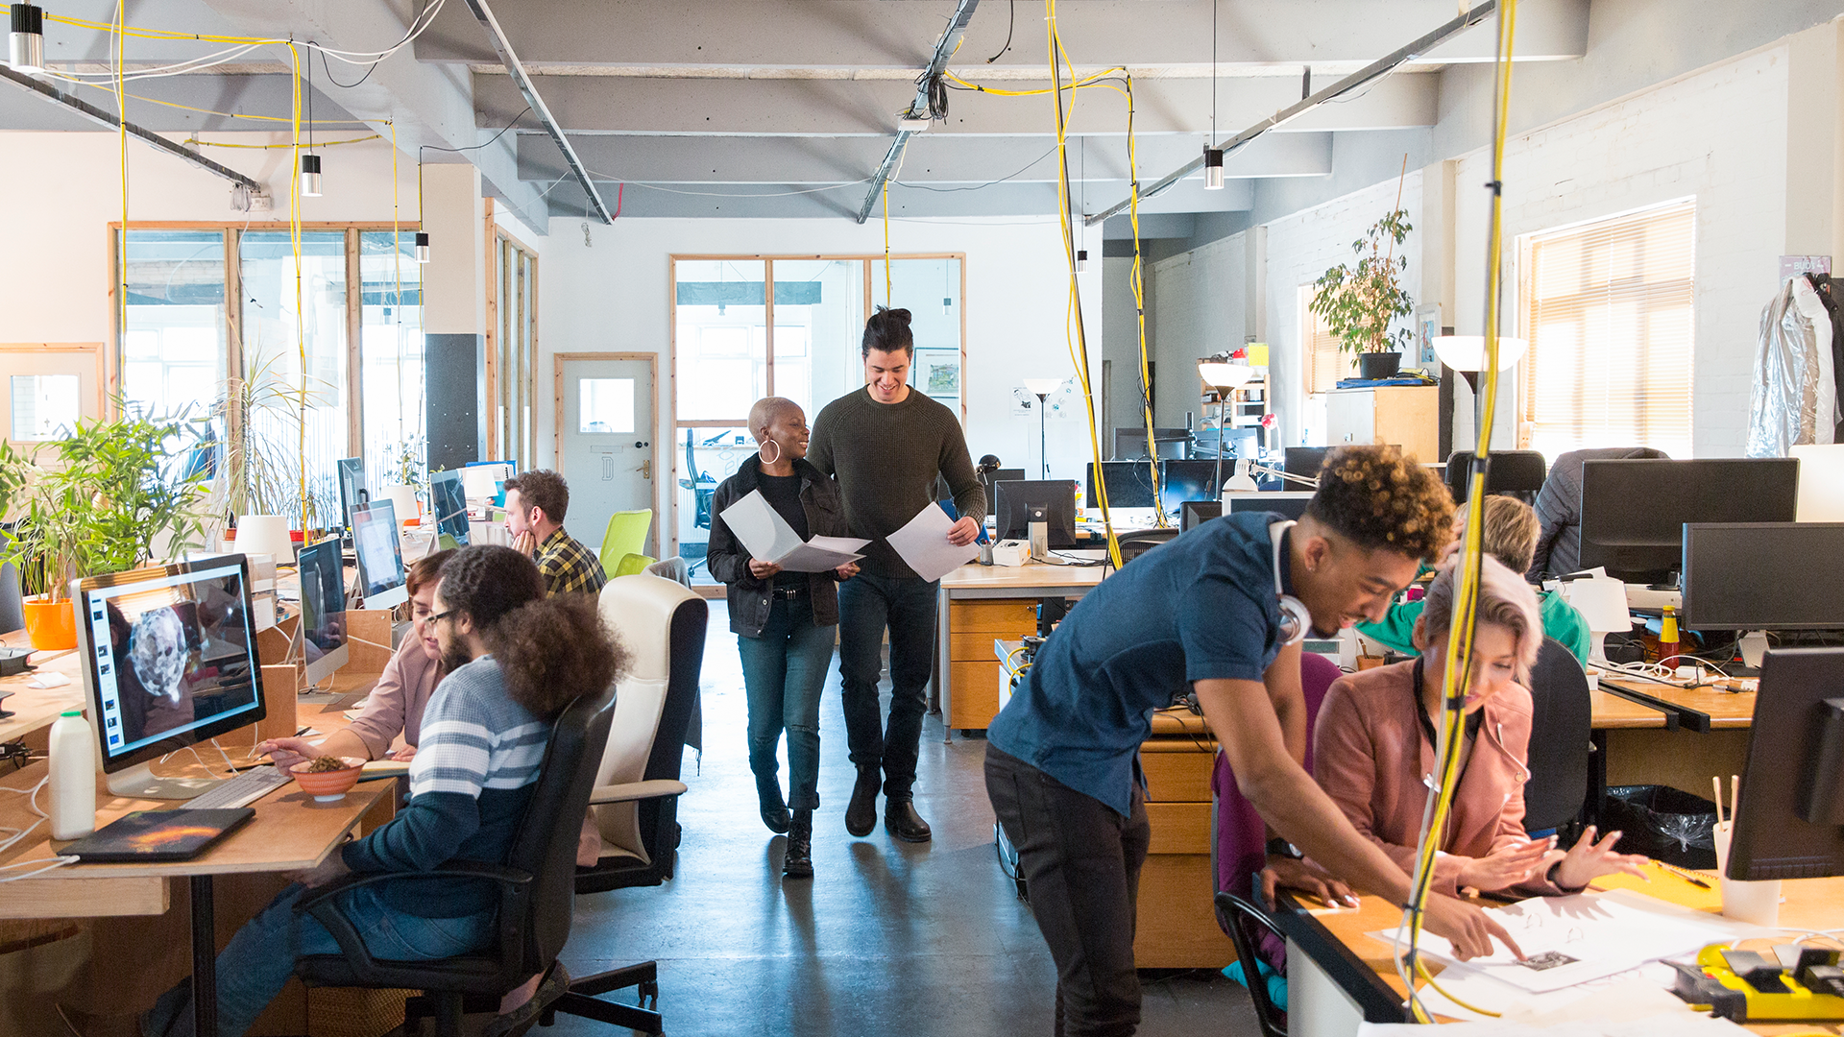

.
5. Add a value proposition
.

Slide 24
.
[our company] is where
[our audience] gets
[what information] that offers
[what benefit].

Slide 25
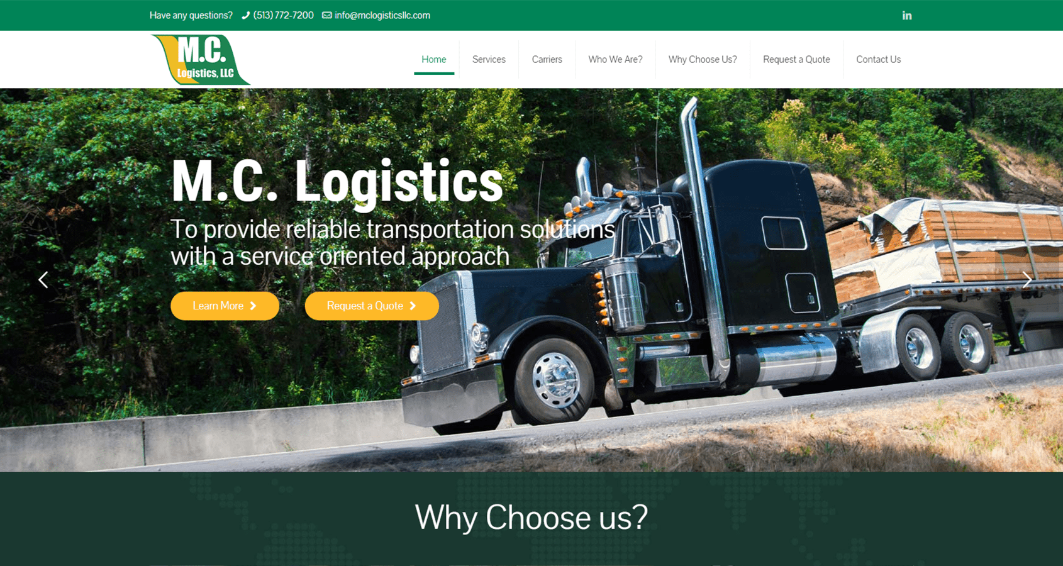

Slide 26
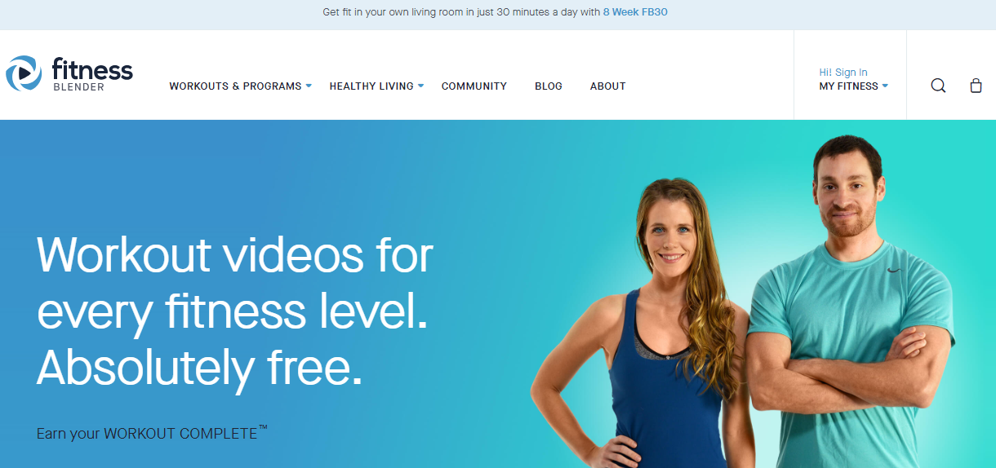

Slide 27
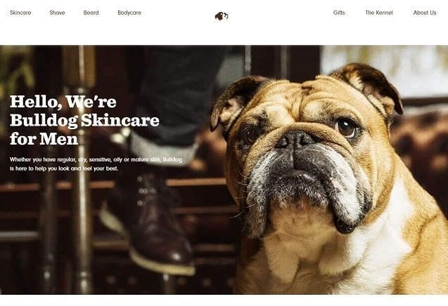

Slide 28
6. Improve Your Website’s
A D V A N C E M E D I A N E W Y O R K
Notes:
Make sure people can navigate your site, find what they’re looking for, and consume the content. A professional web agency can help you identify the good and bad parts of your site and provide recommendations on how to improve the user experience; ultimately making information finding quicker and easier, increasing conversions, lowering the cost of acquisition, and bringing in more customers. Forrester Research reports that, on average, every dollar invested in UX brings $100 in return.

Slide 29
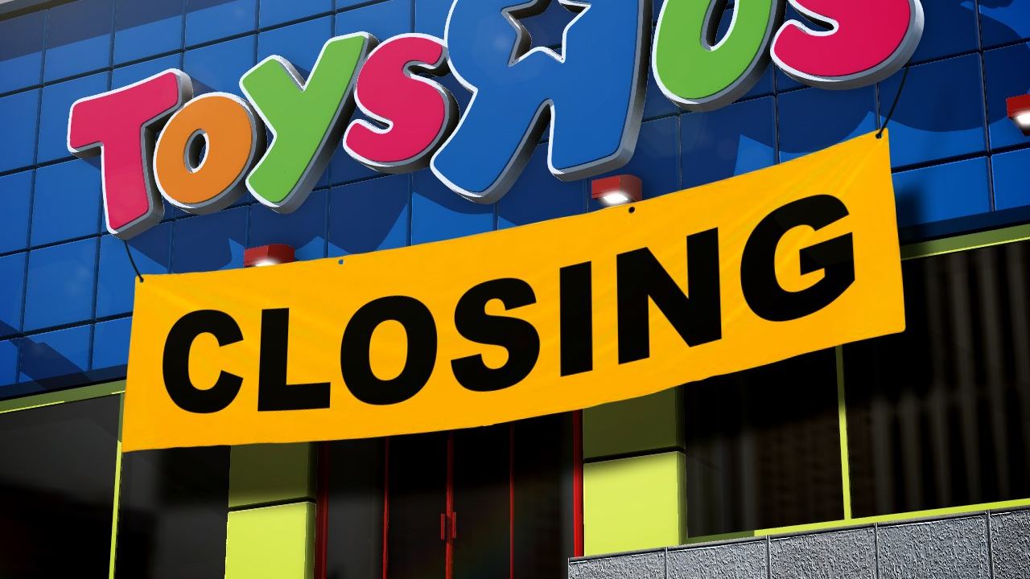
Notes:
According to an article on INC. (Nov. 2017): Toys R Us filed for bankruptcy in September 2017 due to: $5 billion debt, inability to keep pace with online retailers, failure to offer prices competitive with big box stores.
Final nail in the coffin was their digital presence. It was clunky and the user experience was awful.
Companies that are not investing in the digital transformation of their organization are more likely to be susceptible to disruption in the market. While Toys "R" Us updated and streamlined the user experience for their website earlier that year, the damage was done. Ensuring that your customers have a seamless online experience is vital.

Slide 30
.
Common Mistakes

Slide 31
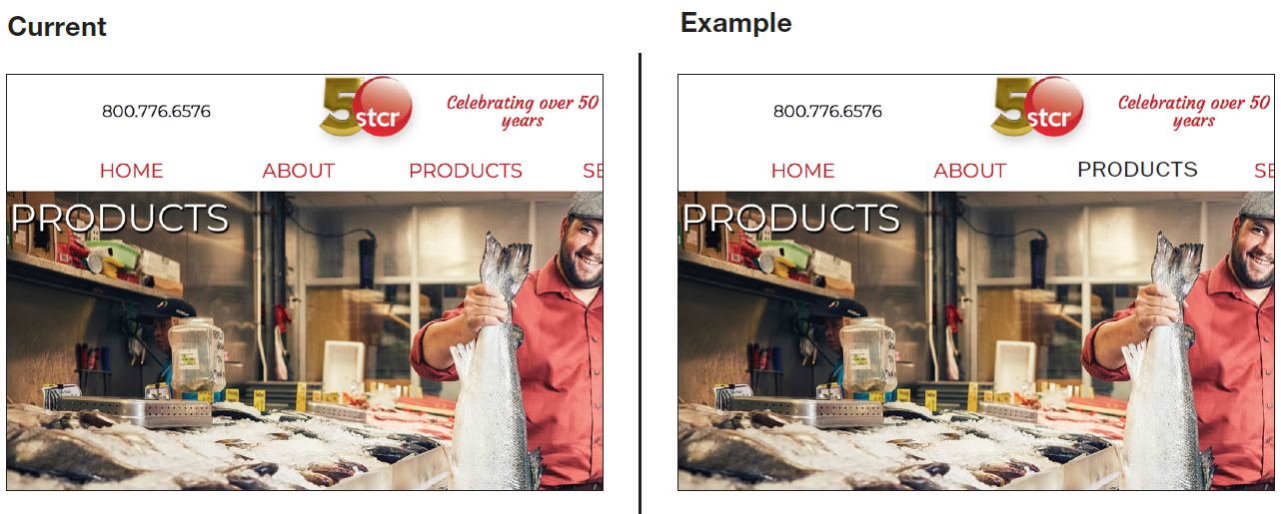
Navigation Does Not Give User Any Feedback
Notes:
This makes it difficult for a user to tell what their current location on the website is. Consider visually altering the link in the navigation to allow users to quickly identify their location on the website.

Slide 32
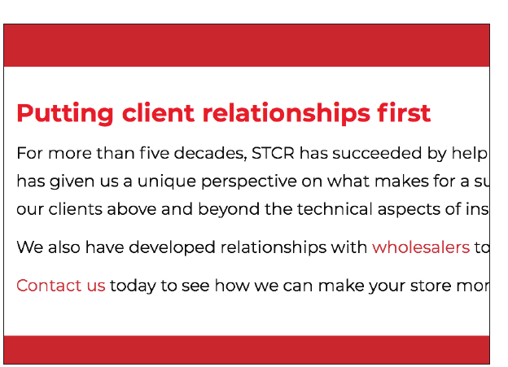
Same Color Used for Text Elements and Links
Notes:
When interactive elements utilize the same color as text elements, the user may click on text elements and assume they are broken links. Consider using a different color for text elements, so that the user can quickly and easily identify where they can click.

Slide 33
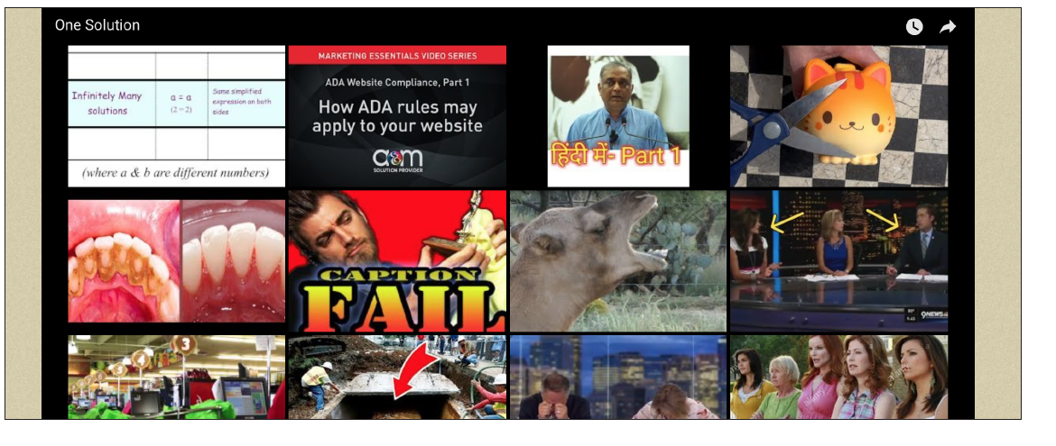
YouTube Video Suggestions Display at Completion of Video
.
Tip: Add ?rel=0 to the end of the YouTube video source URL
Notes:
When YouTube is allowed to suggest videos, your business has no control over the content that plays on your website. This could be damaging to your brand. It could also lead your customers to competitors. Consider adding ?rel=0 to the end of the YouTube video source URL to stop YouTube from recommending videos.

Slide 34
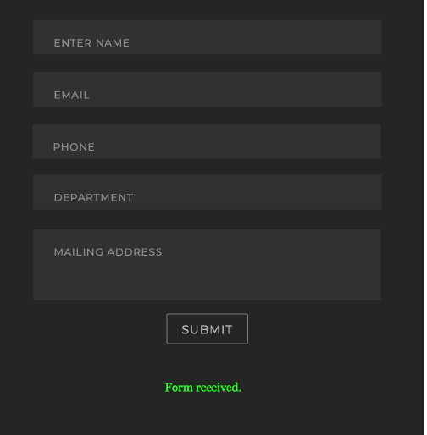
Confirmation
.
Page
A D V A N C E M E D I A N E W Y O R K
Notes:
The confirmation page is often a missed opportunity to further engage the user. The lone confirmation message creates an awkward ending to the interaction of a form fill. Presenting the user next steps that they can take, gives them the opportunity to further interact with your brand while they wait to be contacted. Consider redirecting users to a page with your social media channels to provide them with next steps you want them to take in interacting with your brand. Teasing the types of information they will find on these channels will communicate the value of these connections for the user and help you capitalize on these secondary conversions.

Slide 35

.
7. Do a three second,
10-foot test
Notes:
Do a 3 second, 10-foot test. Are your web pages effectively communicating the intended message? Stare at a page on your site for 3 seconds (or better yet, have your friends do it) Why 3 seconds? Three seconds is long enough for a good design to communicate its main message, and people often open multiple sites at once, reducing the attention each site receives and increasing the importance of effective design and messaging. Open up your screen and walk past it. Especially the homepage. Then, ask:
What is the purpose of the page?
What are the main elements you can recall?
Who do you think the intended audience is?
Did the design/brand appear trustworthy?
What was your impression of the design?

Slide 36
3 Second, 10-Foot Test
What is the purpose of the page?
What are the main elements you can recall?
Who is the intended audience?
Did the design and brand appear trustworthy?
What was your impression of the design?
A D V A N C E M E D I A N E W Y O R K
Notes:
Who owns my domain: Often times, the developer does. Often the case with companies who specialize on one industry, like law firms, or funeral homes, or insurance companies.

Slide 37
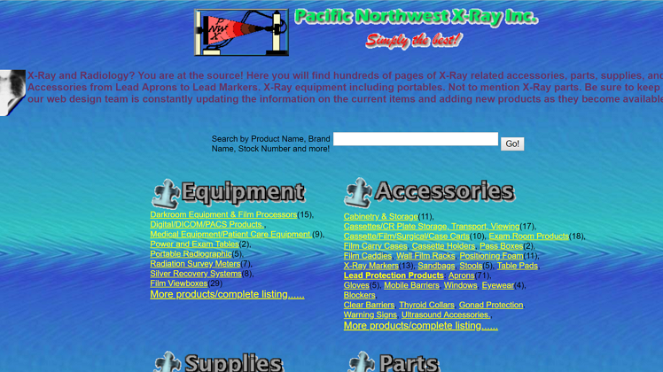

Slide 38
What is it?

Slide 39
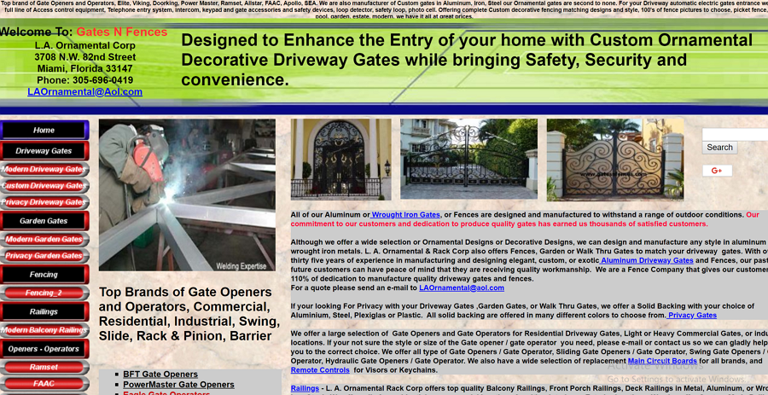

Slide 40
What is it?

Slide 41


Slide 42
What is it?

Slide 43
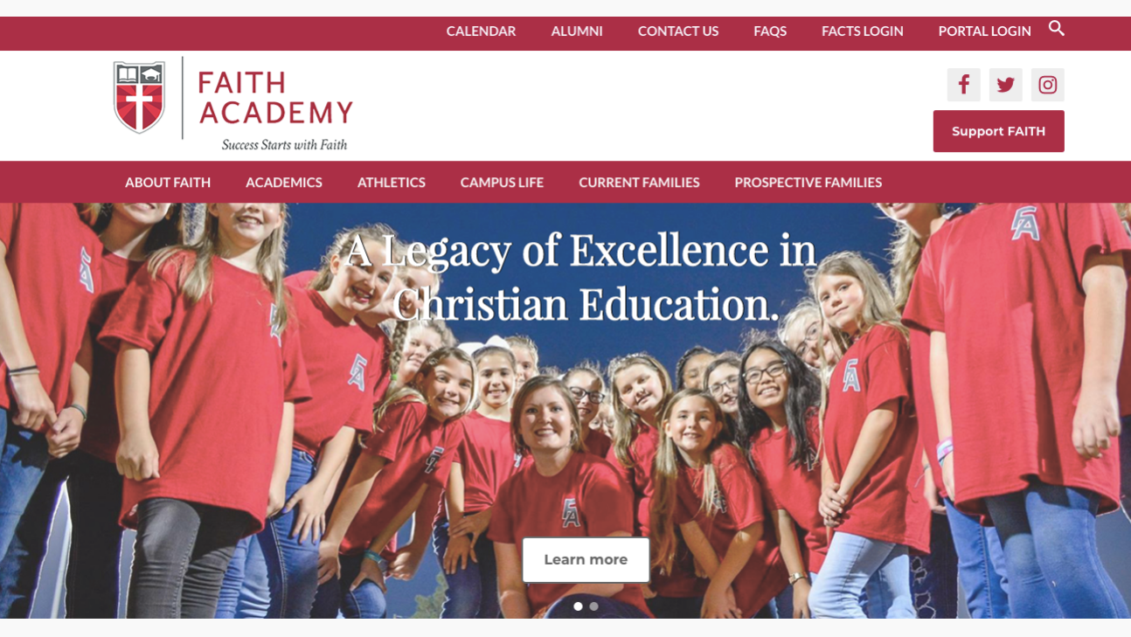

Slide 44
What is it?

Slide 45


Slide 46
What is it?

Slide 47
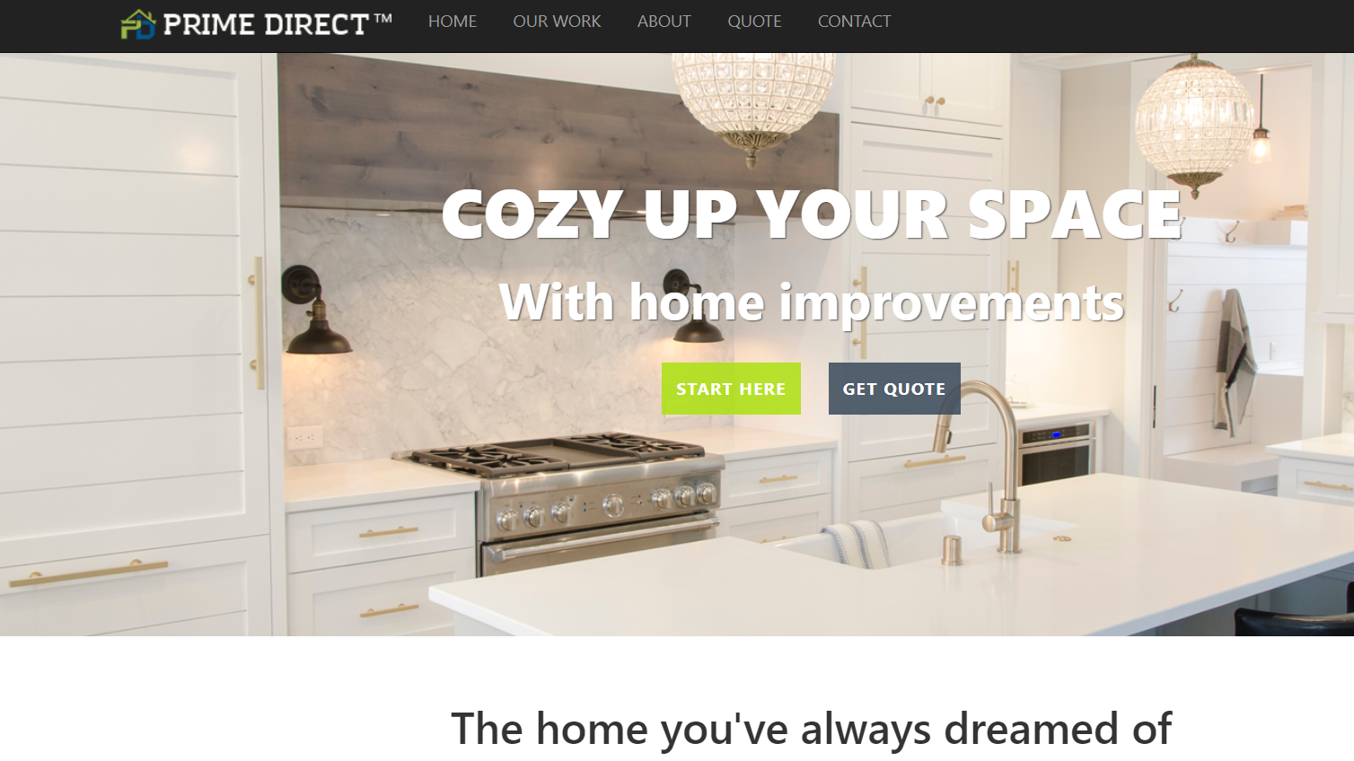

Slide 48
What is it?

Slide 49
What to ask your developer
Who owns my domain?
Is my site secure?
What’s your process for building my website?
What SEO services do you offer? What’s the ongoing plan?
Will you build it on your own, or outsource some of it?
Will I have access to make changes, or do you need to do it? Cost?
A D V A N C E M E D I A N E W Y O R K
Notes:
Who owns my domain: Often times, the developer does. Often the case with companies who specialize on one industry, like law firms, or funeral homes, or insurance companies.

Slide 50

Questions?

