Slide 1
Digital Marketing Bootcamp
Using Market Research to Drive Content Marketing
Using Primary and Secondary Sources

Slide 2
What Will We Cover Today?
Statistics about content marketing
Why your content may not be performing
Free secondary research tools to help inform content
Examples of using surveys and research to build content

Slide 3
What is Content Marketing?
“Content marketing is a strategic marketing approach focused on creating and distributing relevant, valuable, and consistent content to attract and retain a clearly defined audience — and, ultimately, to drive profitable customer action”

Slide 4
Examples of Content Marketing
Blogs
Website Copy
Whitepapers and Webinars
Press Releases
Infographics
Social Snackables
YouTube Videos
Compare/Battle Cards
Sales Collateral
Case Studies
eBooks

Slide 5
Why is Content Marketing Important?
Show Me To Your Boss
7.8x Year-over-year unique site traffic is 7.8x higher for content marketing leaders | 62% Content marketing costs 62% less than traditional marketing and generates 3x leads | 81% Percent of marketers who plan to increase the use of original written content
126% Small businesses with blogs get 126% more lead growth than small businesses without one | 43% Percent of people who admit to skimming blog posts, not reading them in full | 47% Of buyers who viewed 3 to 5 pieces of content before engaging with a sales rep
Via neilpatel.com, contentmarketinginstitute.com, and hubspot.com

Slide 6
How Content Marketing is Supposed to Work
Publish
Find
Trust
Action
Value
Solution

Slide 7
How Content Marketing Usually Works
Never Published
Not valuable
No Answers
Not optimized
Exit
Too salesy

Slide 8
What’s Causing Content Problems?
Knowledge: Where do I start?
Writer’s Block: What do I write about?
Novel Mentality: Too many authors
Time: I don’t have enough time!
Use sites like nDash.co for writers
Too Technical: Think about interviews
Budget: We don’t have the resources

Slide 9
3 Types of Content Marketing Research
Secondary data and sources
Primary data you have
Primary data you can obtain

Slide 10
Option 1: Secondary Data and Sources
AnswerThePublic.com
Statista
Google Analytics
Google AdWords Keyword Planner

Slide 11
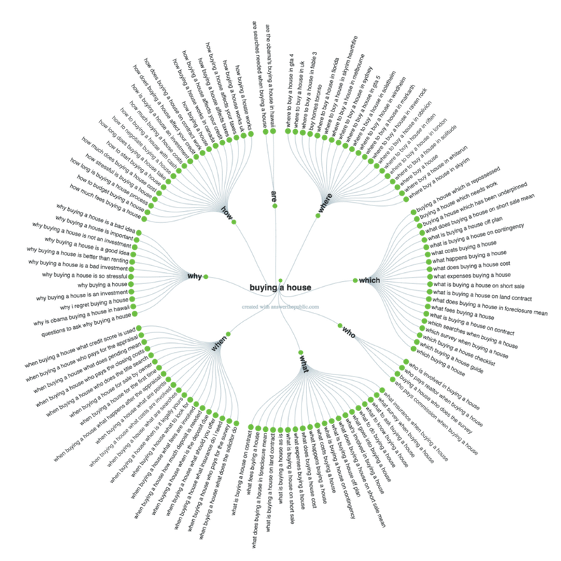
AnswerThePublic.com
Answer The Public is a keyword tool that visualizes search questions and suggested autocomplete searches in an image called a search cloud. Categories consist of Which? Who? What? When? Why? How? Are? Where? The free version allows 4 inquiries a day.
Which websites are best for buying a house
Who pays the realtor when buying a house
What questions to ask when buying a house
When buying a house for the first time
Why buying a house is an investment
How to negotiate when buying a house
Are realtors needed when buying a house
Where to buy a house in Syracuse

Slide 12
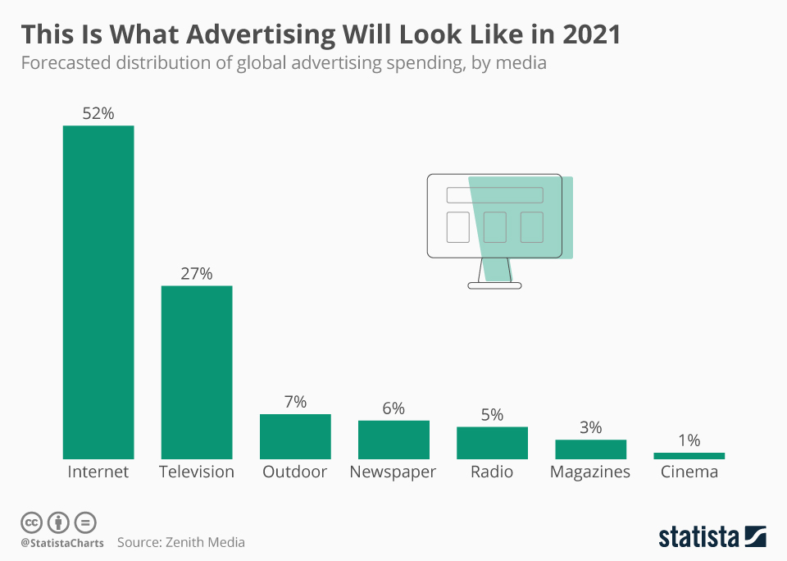
Statista.com
Via LinkedIn: The LinkedIn Marketing Solutions team found that status updates that include statistics along with a link to content get 162% more impressions and a 37% higher click through rate.
On social there is too much promotion and not enough people posting to help others. Data to help your audience or readers could change that.

Slide 13
Google Analytics
Rely on the following to help you understand on-site pages (website and blog) which perform best to create similar content:
Behavior > Site Content > All Pages
Review unique visitors, page views, and average time on page
Review not only high traffic/visit posts but also pages with lower traffic and higher engagement. These could be posts that need to be repurposed or shared elsewhere because they indicate high value.
Don’t forget to review your Google AdWords search queries too for SEO content ideas

Slide 14
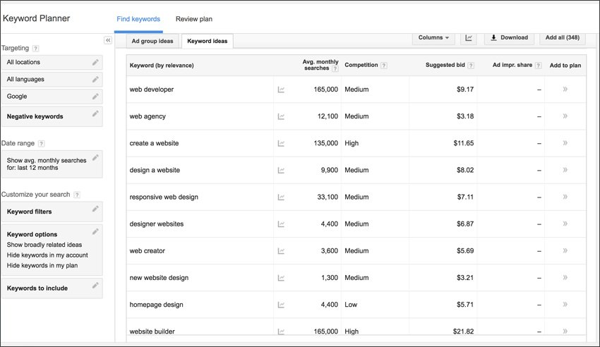
Google Keyword Planner
Review search terms and content ideas using average monthly search data.
Think about designing content for those with medium to low competition versus high. High competition makes it tougher to rank and often takes long-form posts to compete.
Helps with content heading like:
Using sandwich vs. sub shop
Construction firm vs. company
Travel tips vs. Tourism tips

Slide 15
Option 2: Primary Data You (May) Have
Customer survey data
Salesforce comments and notes
Customer service platforms (chat)
Zendesk, LiveChat
Customer reviews
Google, Yelp!
Social media comments

Slide 16
Option 3: Primary Data You Can Obtain
Original research
Market/Brand equity surveys
Industry or “State Of” surveys
Competitor surveys
Using a third-party

Slide 17
Ways to Collect Primary Data
Free (but limited) platforms
Survey Monkey, Google Forms, etc.
Email customer lists
Paid social media posts
Purchased email lists or panels
Comment cards

Slide 18
Remember This
Repurpose

Slide 19
Primary Example 1: Blogs
Results from a simple customer satisfaction survey can offer a ton of blog posts
Ask a question in your customer survey about platforms they use, type of content they want to learn more about, etc.
Collect testimonials in the survey
Furniture & Appliance Store Blog Ideas
3 key takeaways from our customer survey
4 things our customers love about our brand
7 things to consider when choosing furniture
Key word associations with our furniture store
How to choose the right dishwasher
Ultimate guide to choosing kitchen appliances

Slide 20
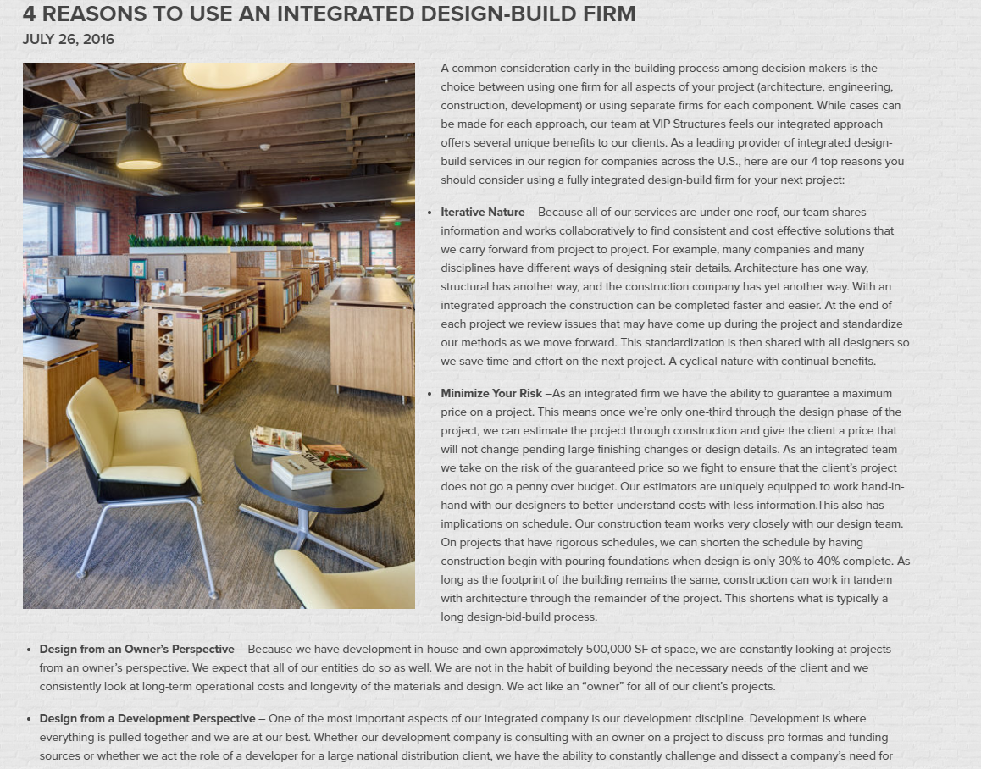
Primary Example 1: Blogs (Continued)
Discovered through client surveys, there were 4 main drivers to choosing VIP

Slide 21
Primary Example 2: Website Copy
User experience (UX) interviews to understand what to feature on the site and what prospects look for. Try Loop11.com.
What factor(s) matter most in choice?
What is the path to purchase?
What pages are most important?
What are they trying to accomplish on-site?
Who is your audience?
What would help them take action on the site?
How do they prefer to contact you?

Slide 22
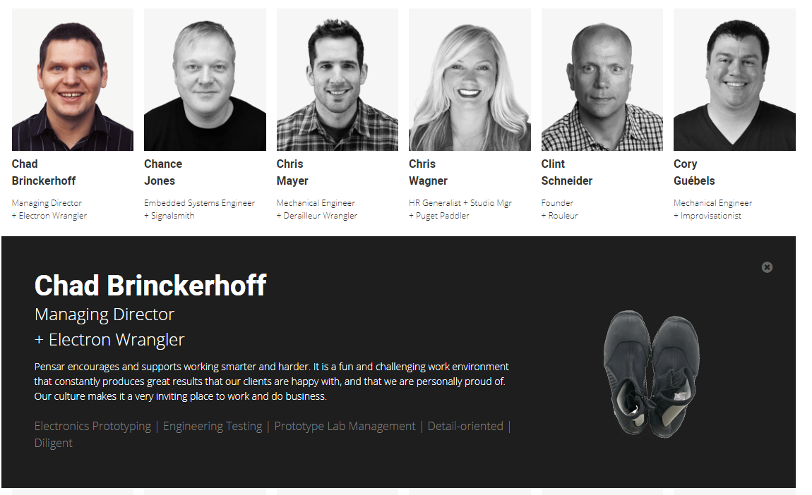
Primary Example 2: Website Copy (Continued)
Product design group for Xbox, Microsoft, etc.
Used a client and employee survey to uncover what clients wanted to see on a website and then used the employee survey to collect information

Slide 23
Primary Example 3: Whitepapers and Webinars
Excellent source of content and lead generation for B2B companies
Survey the market using an email list targeted to titles and roles desired
In-depth downloadable content to capture leads for follow-up
Bonus: unveil through a webinar

Slide 24
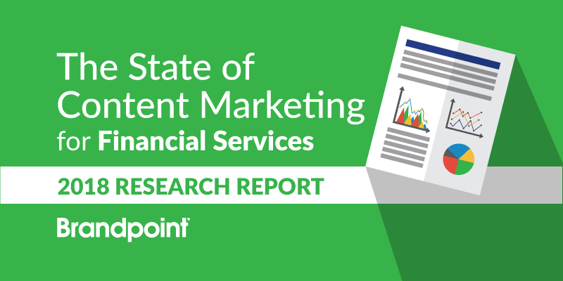
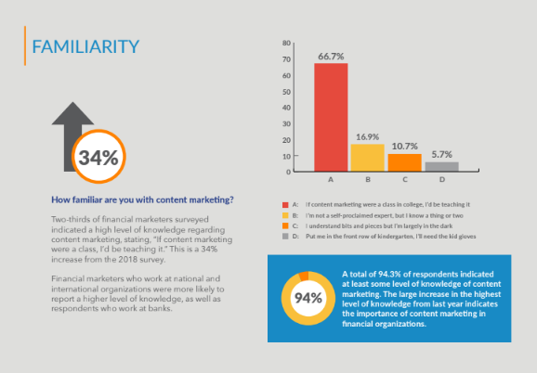
Primary Example 3: Whitepapers… (Continued)
Surveyed bank and credit union marketers to understand views on content marketing
Shared findings in a whitepaper and webinar to pin Brandpoint as a thought-leader in this space to acquire more bank and credit union leads for content marketing

Slide 25
Primary Example 4: Press Releases
Getting press releases published can be a struggle for many businesses
Need to give the journalist something of value, not an announcement
Think about using research findings on the market or your industry
Backlink for SEO

Slide 26
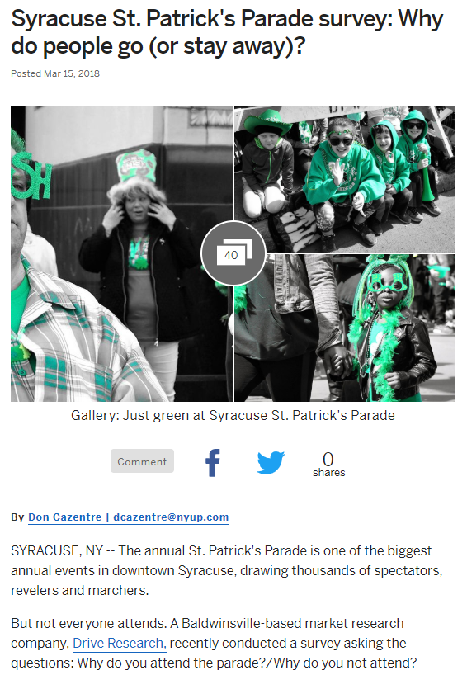
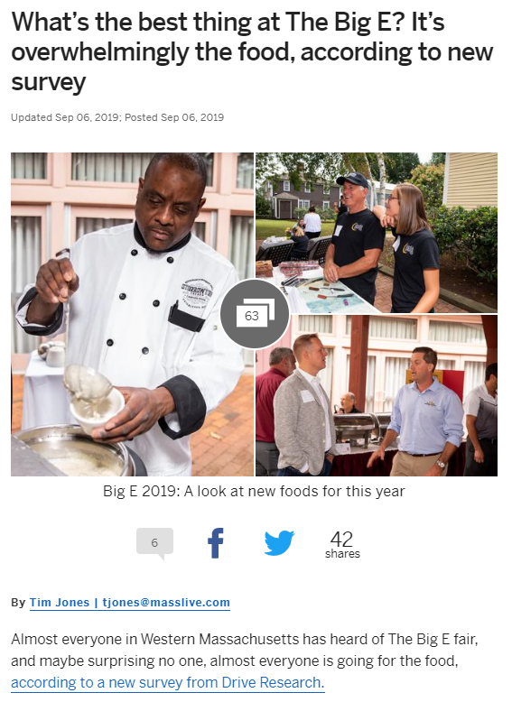
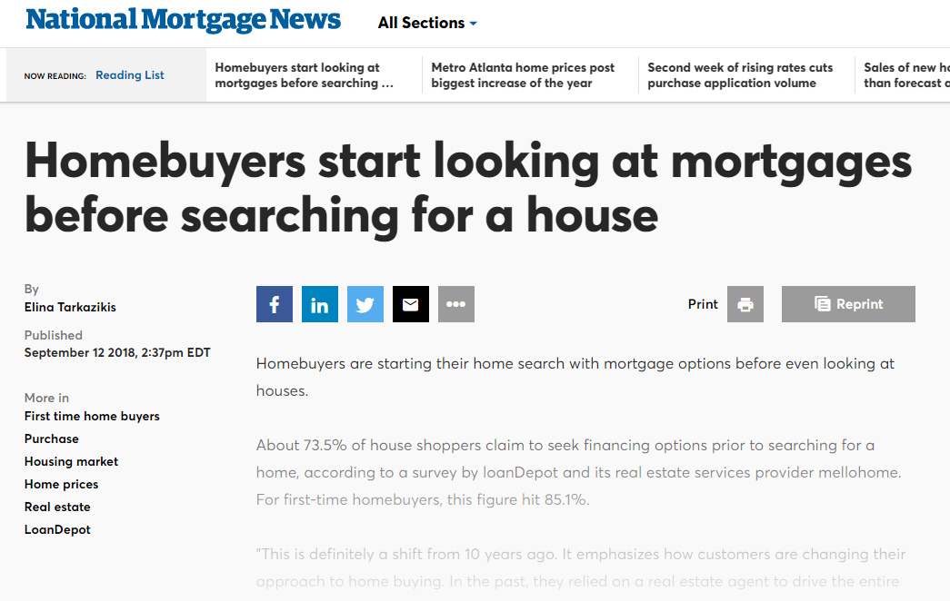
Primary Example 4: Press Releases (Continued)

Slide 27
Primary Example 5: Infographics
Showcase your customer feedback
Excellent for social shares
Easy to repurpose other data into this
Tools such as Visme, Easel.ly, and Canva

Slide 28
Primary Example 5: Infographics (Continued)

Slide 29
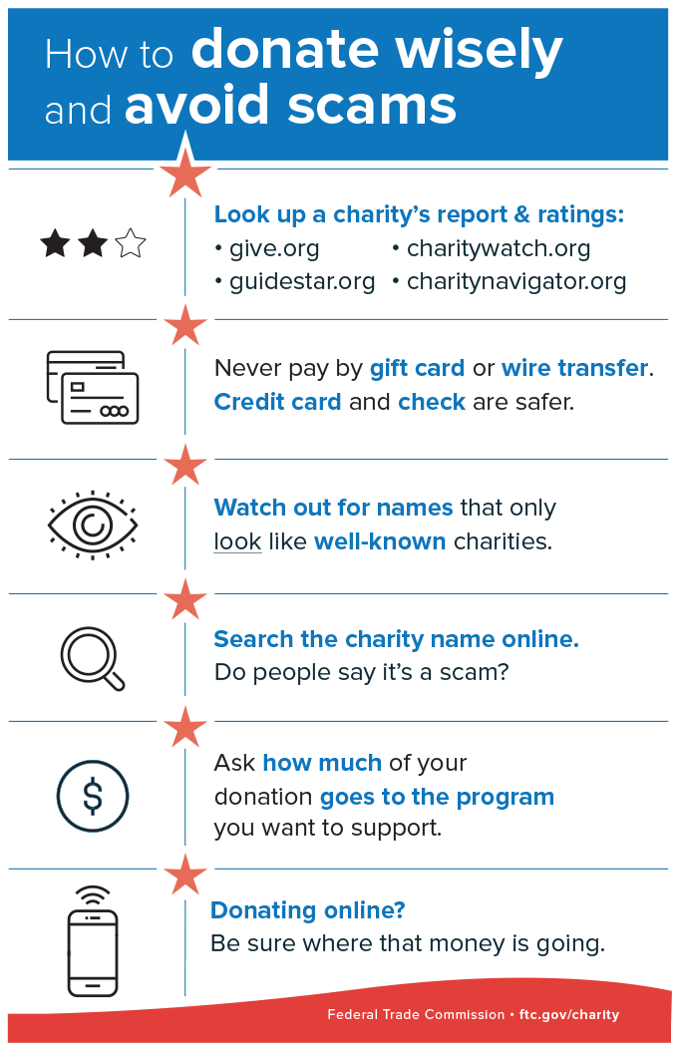
Primary Example 6: Social Snackables
Repurposing nuggets, data, etc.
Think about the platforms your users are on: Instagram, Facebook, Twitter, LinkedIn, etc.
Facebook has the highest 30-day usage rate of any social platform in the Syracuse DMA

Slide 30
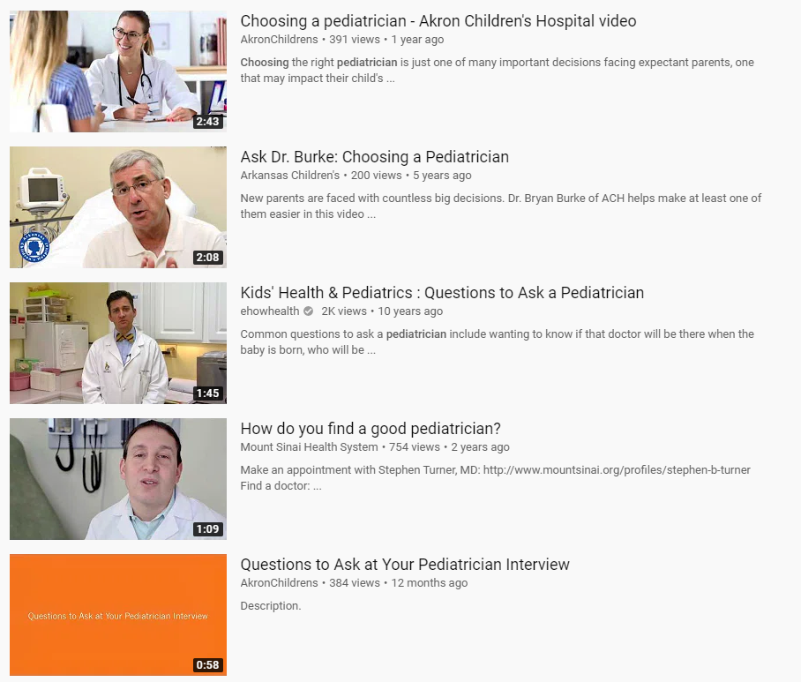
Primary Example 7: YouTube Videos
Repurposing content from blogs, social, etc. into short videos
Think quick videos on tips/tricks
Use content already created
YouTube is the second largest search engine (used for B2C and B2B)

Slide 31
Primary Example 8: Compare/Battle Cards
Using a third-party to assess your brand equity vs. competition
Understand strengths and weaknesses
Great sales tools and collateral
Better is the opinion of the buyer, not the seller.

Slide 32
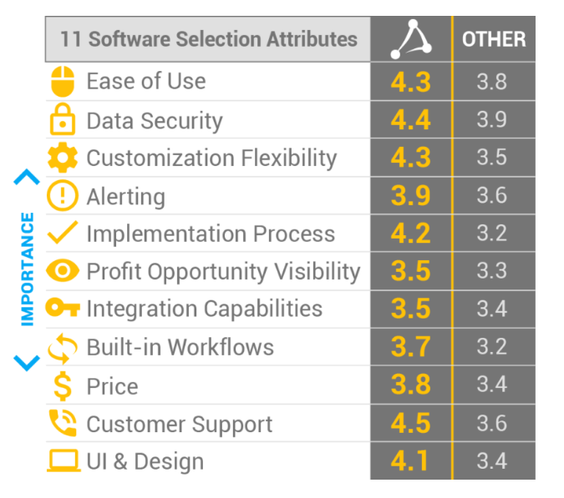
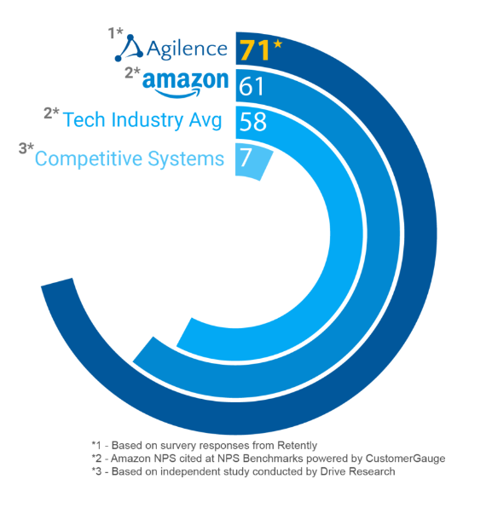
Primary Example 8: Battle Cards… (Continued)

Slide 33
Primary Example 8: Battle Cards… (Continued)

Slide 34
3 For the Road
Make your content efforts worth it, repurpose into many formats
Provide answers for your most common customer questions
Focus on HELPING your customers, not selling to them

Slide 35
Questions and Answers

